Slide 1
Protective Barriers Designed via HSP
Prof Steven Abbott
Steven Abbott TCNF Ltd
Visiting Professor U Leeds
steven@stevenabbott.co.uk, www.stevenabbott.co.uk
HSP50 Conference, York, 5-7 April 2017
Note: The PPt shows screen shots. The talk will use live software/apps

Slide 2
Four factors controlling diffusion
The concentration C in the top 1nm of the barrier
This drives the concentration gradient across the barrier
Such concentrations are known for a few solvents in a few polymers but generally have to be estimated
The thickness of (each part of) the barrier
This affects the concentration gradient and the diffusion time
The thicknesses are known so do not need to be estimated
The diffusion coefficient D of the molecule in the polymer
This depends on the polymer (crystalline polymers have smaller coefficients) and on the molecule (lower values for larger, branched or rigid cyclic molecules)
The effect of concentration on the diffusion coefficient
The more solvent in the polymer, the more “open” the polymer, so the faster the solvent can move
Once we know those parameters we can model diffusion precisely with standard numerical techniques (finite difference)
And we can do it over multiple layers of different polymers

Slide 3
Predicting the factors: D
The low-concentration diffusion coefficient D is known for many standard polymers and typical small solvent molecules
The correction for molecular size and the effect of temperature on D can also be estimated using a semi-standard formula from the packaging industry.
Although the concentration dependence can be estimated, the permeation rate of any such polymer is so catastrophic that it’s currently not worth adding the extra numerical complexity.
http://www.stevenabbott.co.uk/practical-solubility/diff-d-values.php

Slide 4
Predicting the factors: C
The concentration, C, of a solvent in the polymer can be estimated via any relevant solubility theory using the timeless Flory-Huggins theory and the χ parameter which describes the “badness of fit” between the solvent and the polymer
To the best of my knowledge, the only practical theory available for such calculations is Hansen Solubility Parameters
The χ parameter is directly calculated from the HSP Distance². So knowing the HSP of polymer and the permeant, C can be estimated from first principles

Slide 5
No polymer is good enough
There is no polymer which, on its own, is a good enough barrier for a wide range of solvents
If the HSP Distance is large (good barrier) for one class of solvents (e.g. the hydrocarbons) it might be small for another class (e.g. alcohols)
So all viable, general purpose barriers must be multi-layer
So the simplest of food packaging is a multi-layer sandwich of, say, PE, EVOH, PE where the 4μm of EVOH provides a strong barrier for the hydrophobic materials that easily pass through PE, but the PE provides a barrier for hydrophilic materials for which EVOH is useless
Or, if you have a single polymer it is only good for a specific range of chemicals

Slide 6
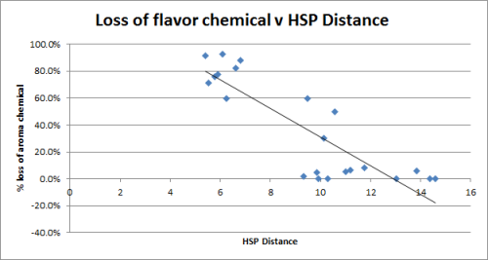
How to get it wrong – flavour scalping
A new concept in drinks – concentrated flavours in a small polymer package
Some components lost quickly over days
Food industry “experts” could not explain it
Given the 20 components I could quickly estimate their HSP and create this graph
Not a perfect plot, but good enough
The project, sadly, died
No single alternative and no multi-layer possibility
The food industry in general understands diffusion but HSP are under-utilised
I’ve predicted that cinnamon buns should not be wrapped in PLA protective filme

Slide 7
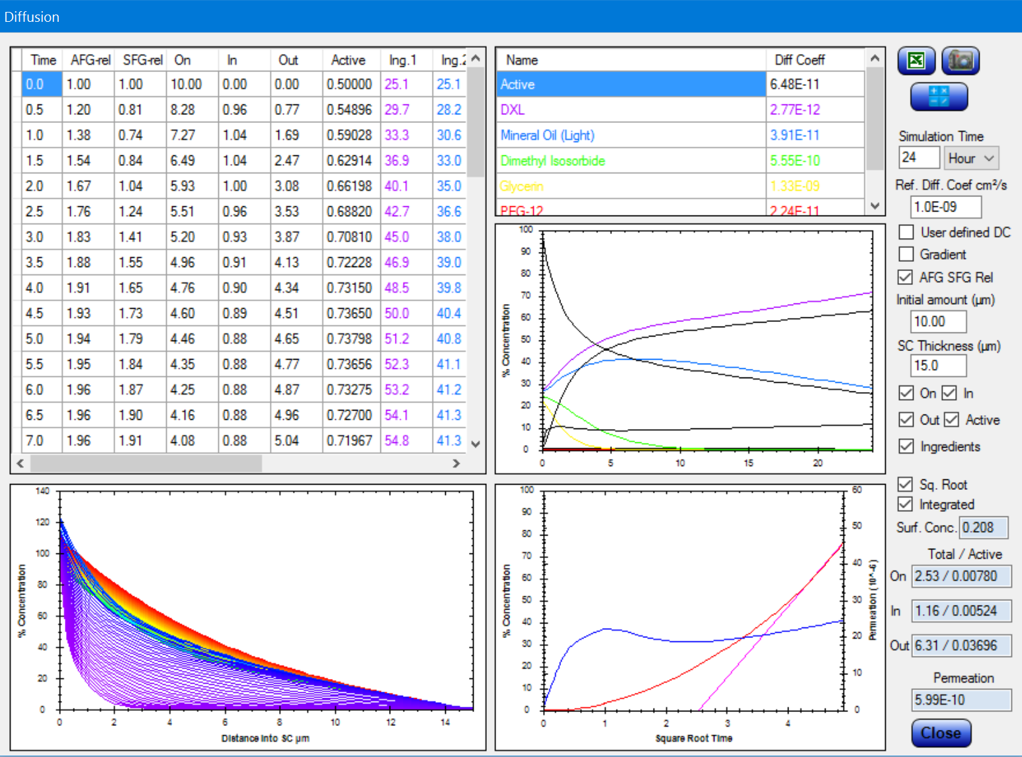
How to get it right – Skin permeation
The pharma and cosmetics industries have obsessed about LogP for designing skin permeating formulations
It simply doesn’t work, nor can it work
Hansen many years ago measure the HSP of skin, assuming that it was a normal polymer
Using that basic assumption, we can model skin permeation as an HSP-driven diffusion problem
The FFE package is now used around the world to do such modelling
The Diffusion calculator within Formulating for Efficacy
Program by Abbott/Wiechers
Supplied by ACT Solutions
https://www.jwsolutionssoftware.com/

Slide 8
How to get it right – The Japanese Coastguard
When they have a leaking cargo on a ship, what protective clothing should they use?
It’s all decided using HSP
Selection of a chemical substance protective clothing to be used at the time of handling a hazardous material accident including chemical substances will bother the accident responder if the resistance information on the chemical substance is missing.
We considered using Hansen Solubility Parameters as a support for selection decisions.
As a result it is said that we could not make proactive judgment material that is resistant and usable.
But we could be used HSP as a passive judgment material.
Selection of chemical protective clothing by HSP

Slide 9
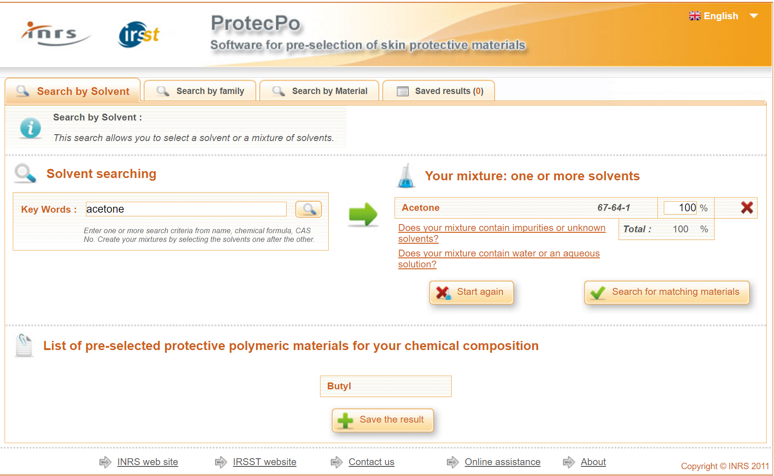
How to get it right – ProtecPo for gloves
You have a chemical and want a safe glove
Just ask on-line!
The ProtecPo team used the HSP Sphere technique to measure the HSP of the key glove materials then use a large HSP database of chemicals to find the best match (biggest Distance)
Hansen’s original work with the US Coastguard was the basis for the approach and Hansen has assisted the ProtecPo team
Prof Lara from U Montréal, is here at HSP50
The ProtecPo app from U Montréal/INRS/IRST
https://protecpo.inrs.fr/ProtecPo/jsp/Accueil.jsp

Slide 10
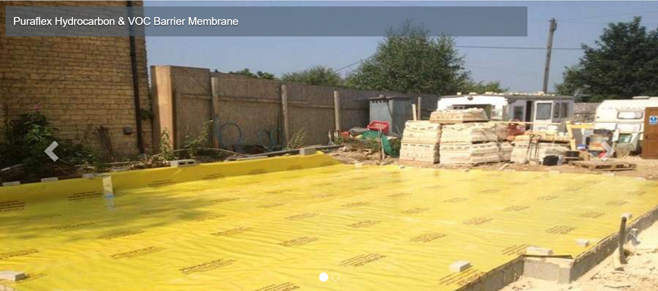
Your house on a brownfield site
The soil is contaminated with a cocktail of chemicals
You want to build houses here
So you install a permeation barrier
You can only build these houses if an environmental specialist has calculated that the levels of chemicals permeating through the barrier are below agreed levels
How does the specialist do that calculation?

Slide 11
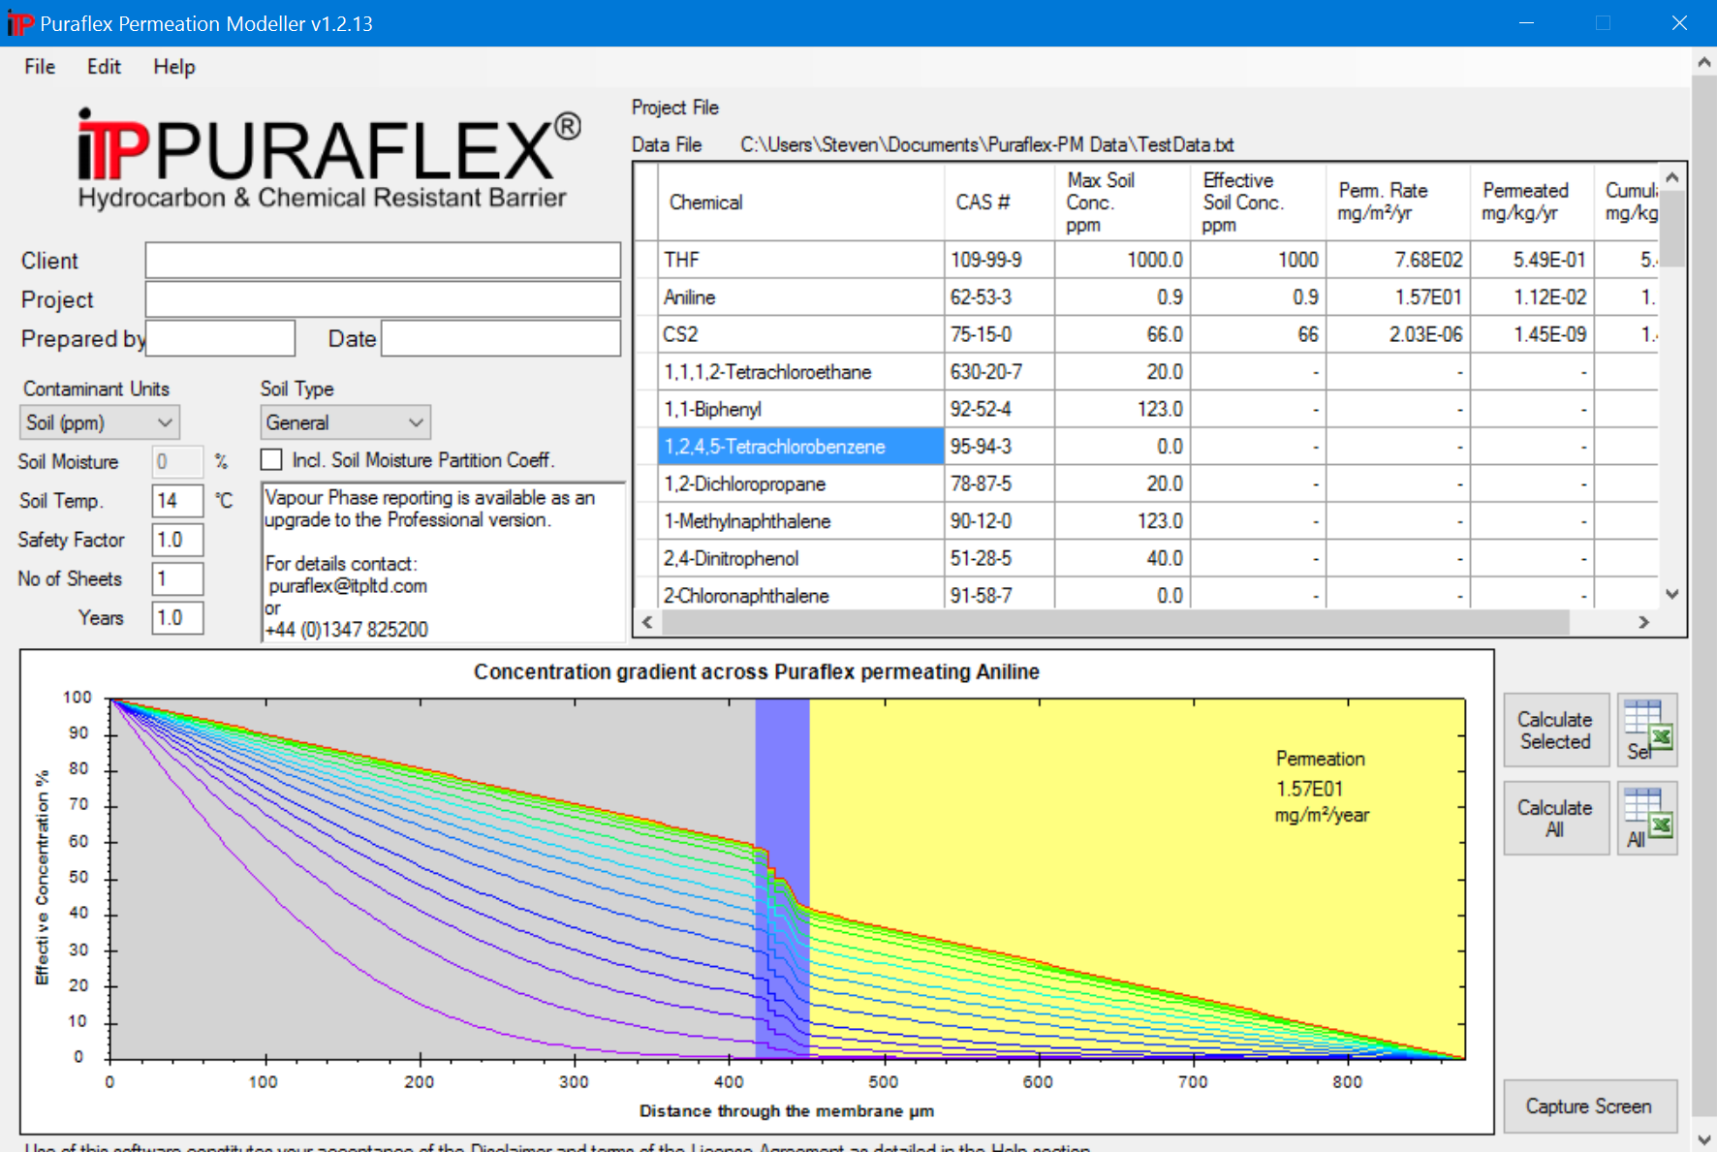
A full HSP-driven diffusion calculator
The methodology of the calculations is public domain
C calculated via HSP, D estimated from the polymers and the molecular shape/size, T-effect estimated by public domain algorithm
The strengths and limitations are known
All assumptions are explicitly pessimistic
In the hands of a specialist the results are accepted as evidence for choosing an acceptable geo-membrane
The Puraflex calculator written by Abbott/Hansen for ITP

Slide 12
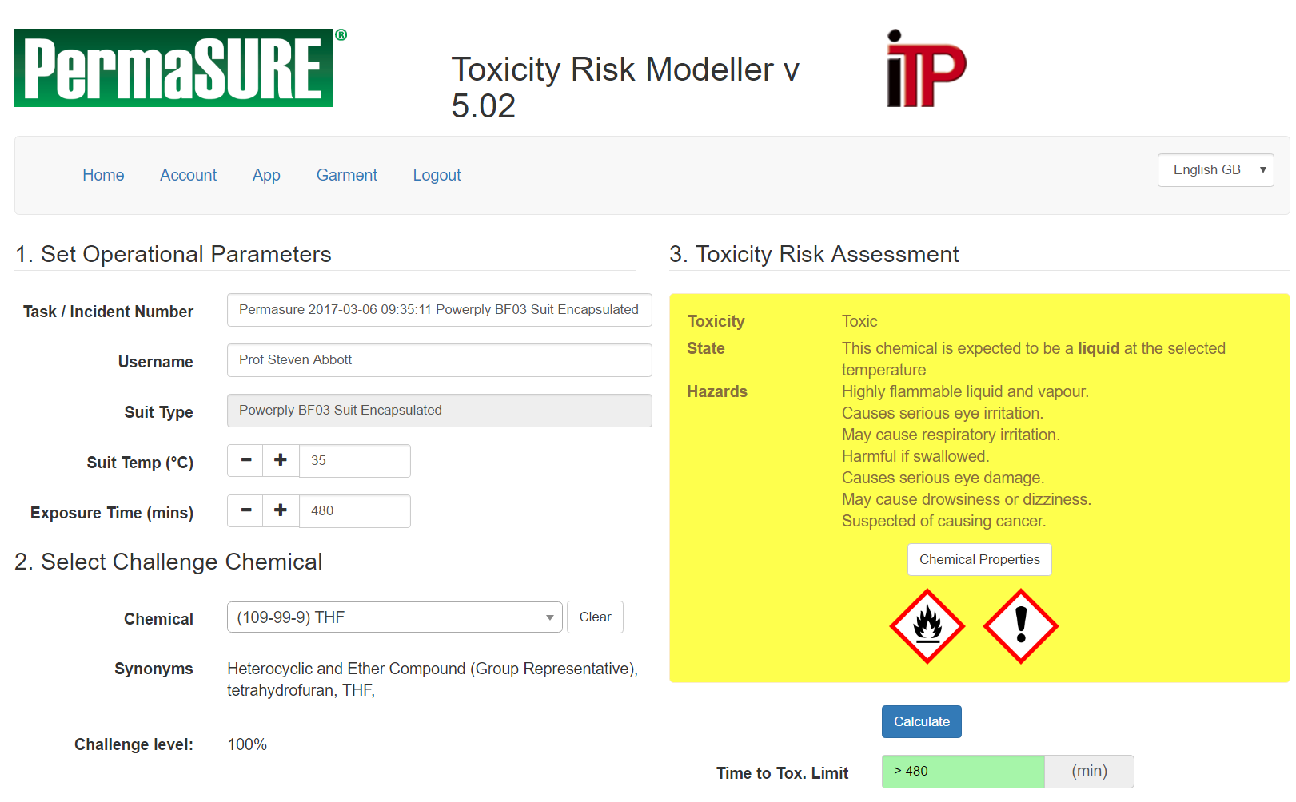
Emergency Response
I am driving to a big spill of THF. I have no idea what THF is and no idea what chemical suit will give me long-enough protection
I open my iPhone, run the PermaSURE app and it tells me that my choice of suit will be OK for more than 8hrs
I also get lots of H&S info
As with the environmental membrane, the methodology (identical) is public domain, the assumptions open and pessimistic
The ITP PermaSURE app written by Abbott/Broadbent

Slide 13
The take-home lesson
The science of diffusion is well-known
We can use standard the Fickian model in most relevant cases
Hansen’s analysis of some of the more complex cases can be found on the Diffusion apps at Hansen-Solubility.com
Diffusion coefficients can be estimated adequately from basic polymer data with some representative solvents
Using HSP it is possible to identify trends in barriers of all kinds – food, drinks, skin, environmental, pharma …
But with modern computing power, a good chemical dataset and some carefully-validated HSP-Distance calculations we can do powerful work predicting permeation

Slide 14
My thanks to:
Dr Charles Hansen
Mark Chandler, ACT Solutions (FFE)
Prof Jaime Lara, Université de Montréal, (ProtecPo)
Richard Menage, ITP (Puraflex and Permasure)

